Slide 1
Chapter 1
Computer Abstractions and Technology
Notes:
Morgan Kaufmann Publishers
Chapter 1 — Computer Abstractions and Technology

Slide 2
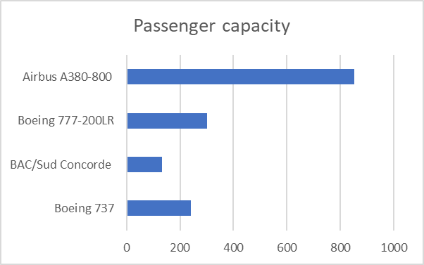
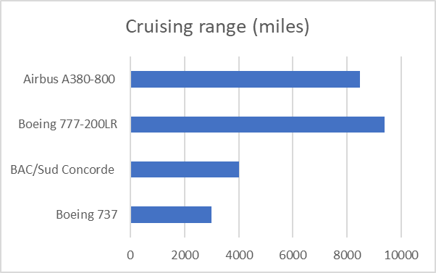
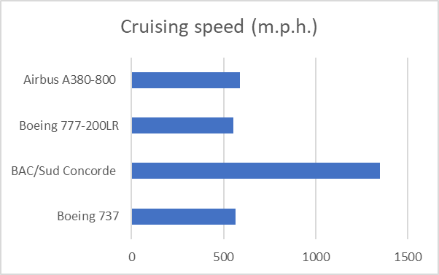
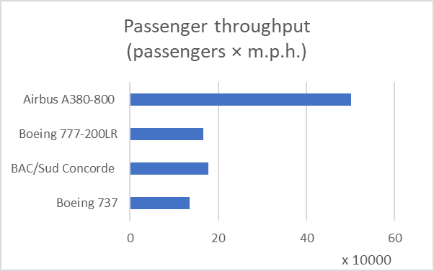
Defining Performance
§1.6 Performance
Which airplane has the best performance?
Chapter 1 — Computer Abstractions and Technology — <number>
Notes:
Morgan Kaufmann Publishers
Chapter 1 — Computer Abstractions and Technology

Slide 3
Response Time and Throughput
Response time
  How long it takes to do a task
Throughput
  Total work done per unit time
    e.g., tasks/transactions/… per hour
How are response time and throughput affected by
  Replacing the processor with a faster version?
  Adding more processors?
We’ll focus on response time for now…
Chapter 1 — Computer Abstractions and Technology — <number>
Notes:
Morgan Kaufmann Publishers
Chapter 1 — Computer Abstractions and Technology

Slide 4

Relative Performance
Define Performance = 1/Execution Time
“X is n time faster than Y”
Example: time taken to run a program
  10s on A, 15s on B
  Execution Time_{B} / Execution Time_{A}
  = 15s / 10s = 1.5
  So A is 1.5 times faster than B
Chapter 1 — Computer Abstractions and Technology — <number>
Notes:
Morgan Kaufmann Publishers
Chapter 1 — Computer Abstractions and Technology

Slide 5
Measuring Execution Time
Elapsed time
  Total response time, including all aspects
    Processing, I/O, OS overhead, idle time
  Determines system performance
CPU time
  Time spent processing a given job
    Discounts I/O time, other jobs’ shares
  Comprises user CPU time and system CPU time
  Different programs are affected differently by CPU and system performance
Chapter 1 — Computer Abstractions and Technology — <number>
Notes:
Morgan Kaufmann Publishers
Chapter 1 — Computer Abstractions and Technology

Slide 6
CPU Clocking
Operation of digital hardware governed by a constant-rate clock
Clock period
Clock (cycles)
Data transfer
and computation
Update state
Clock period: duration of a clock cycle
  e.g., 250ps = 0.25ns = 250×10^{–12}s
Clock frequency (rate): cycles per second
  e.g., 4.0GHz = 4000MHz = 4.0×10⁹Hz
Chapter 1 — Computer Abstractions and Technology — <number>
Notes:
Morgan Kaufmann Publishers
Chapter 1 — Computer Abstractions and Technology

Slide 7

CPU Time
Performance improved by
  Reducing number of clock cycles
  Increasing clock rate
  Hardware designer must often trade off clock rate against cycle count
Chapter 1 — Computer Abstractions and Technology — <number>
Notes:
Morgan Kaufmann Publishers
Chapter 1 — Computer Abstractions and Technology

Slide 8

CPU Time Example
Computer A: 2GHz clock, 10s CPU time
Designing Computer B
  Aim for 6s CPU time
  Can do faster clock, but causes 1.2 × clock cycles
How fast must Computer B clock be?
Chapter 1 — Computer Abstractions and Technology — <number>
Notes:
Morgan Kaufmann Publishers
Chapter 1 — Computer Abstractions and Technology
What clock rate should we tell the designer to target?

Slide 9

Instruction Count and CPI
Instruction Count for a program
  Determined by program, ISA and compiler
Average cycles per instruction
  Determined by CPU hardware
  If different instructions have different CPI
    Average CPI affected by instruction mix
Chapter 1 — Computer Abstractions and Technology — <number>
Notes:
Morgan Kaufmann Publishers
Chapter 1 — Computer Abstractions and Technology

Slide 10

CPI Example
Computer A: Cycle Time = 250ps, CPI = 2.0
Computer B: Cycle Time = 500ps, CPI = 1.2
Same ISA
Which is faster, and by how much?
A is faster…
…by this much
Chapter 1 — Computer Abstractions and Technology — <number>
Notes:
Morgan Kaufmann Publishers
Chapter 1 — Computer Abstractions and Technology

Slide 11
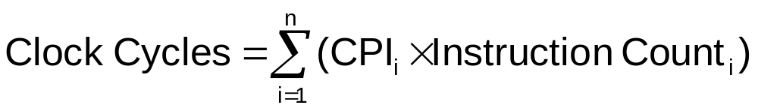

CPI in More Detail
If different instruction classes take different numbers of cycles
Weighted average CPI
Relative frequency
Chapter 1 — Computer Abstractions and Technology — <number>
Notes:
Morgan Kaufmann Publishers
Chapter 1 — Computer Abstractions and Technology

Slide 12
CPI Example
Alternative compiled code sequences using instructions in classes A, B, C
Class | A | B | C
CPI for class | 1 | 2 | 3
IC in sequence 1 | 2 | 1 | 2
IC in sequence 2 | 4 | 1 | 1
Sequence 1: IC = 5
  Clock Cycles
  = 2×1 + 1×2 + 2×3
  = 10
  Avg. CPI = 10/5 = 2.0
Sequence 2: IC = 6
  Clock Cycles
  = 4×1 + 1×2 + 1×3
  = 9
  Avg. CPI = 9/6 = 1.5
Chapter 1 — Computer Abstractions and Technology — <number>
Notes:
Morgan Kaufmann Publishers
Chapter 1 — Computer Abstractions and Technology

Slide 13

Performance Summary
The BIG Picture
** Seconds/Program
Performance depends on
  Algorithm: affects IC, possibly CPI
  Programming language: affects IC, CPI
  Compiler: affects IC, CPI
  Instruction set architecture: affects IC, CPI, T_{c}
Chapter 1 — Computer Abstractions and Technology — <number>
Notes:
Morgan Kaufmann Publishers
Chapter 1 — Computer Abstractions and Technology

Slide 14
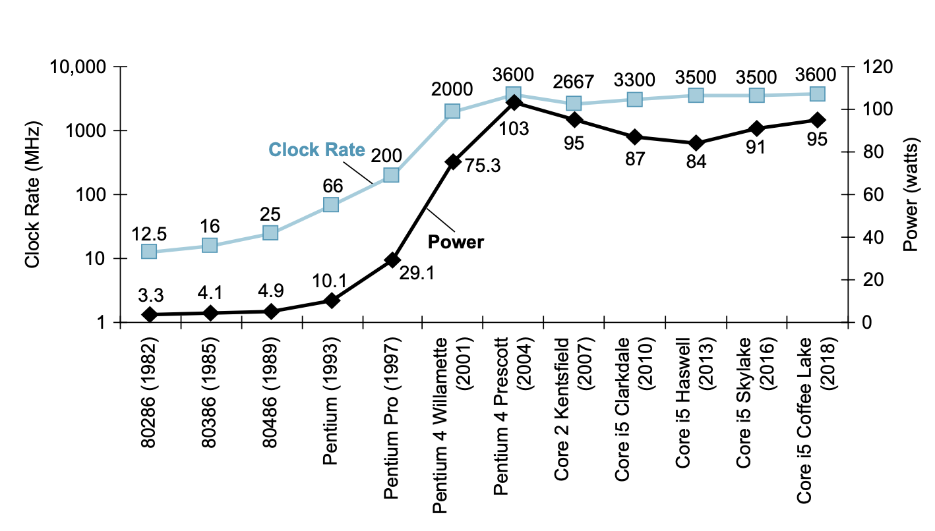
Power Trends
§1.7 The Power Wall
In CMOS IC technology
×30
5V → 1V
×1000
Chapter 1 — Computer Abstractions and Technology — <number>
Notes:
Morgan Kaufmann Publishers
Chapter 1 — Computer Abstractions and Technology
Complementary Metal-Oxide-Semiconductor (CMOS)

Slide 15

Reducing Power
Suppose a new CPU has
  85% of capacitive load of old CPU
  15% voltage and 15% frequency reduction
The power wall
  We can’t reduce voltage further
  We can’t remove more heat
How else can we improve performance?
Chapter 1 — Computer Abstractions and Technology — <number>
Notes:
Morgan Kaufmann Publishers
Chapter 1 — Computer Abstractions and Technology

Slide 16
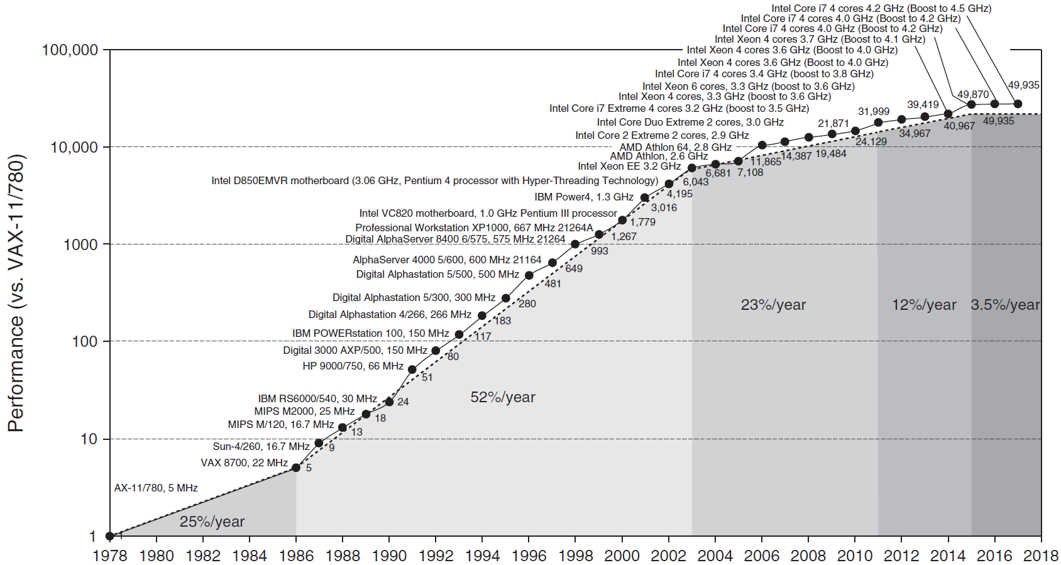
Uniprocessor Performance
§1.8 The Sea Change: The Switch to Multiprocessors
Constrained by power, instruction-level parallelism, memory latency
Chapter 1 — Computer Abstractions and Technology — <number>
Notes:
Morgan Kaufmann Publishers
Chapter 1 — Computer Abstractions and Technology

Slide 17
Multiprocessors
Multicore microprocessors
  More than one processor per chip
Requires explicitly parallel programming
  Compare with instruction level parallelism
    Hardware executes multiple instructions at once
    Hidden from the programmer
  Hard to do
    Programming for performance
    Load balancing
    Optimizing communication and synchronization
Chapter 1 — Computer Abstractions and Technology — <number>
Notes:
Morgan Kaufmann Publishers
Chapter 1 — Computer Abstractions and Technology

Slide 18

SPEC CPU Benchmark
Programs used to measure performance
  Supposedly typical of actual workload
Standard Performance Evaluation Corp (SPEC)
  Develops benchmarks for CPU, I/O, Web, …
SPEC CPU2006
  Elapsed time to execute a selection of programs
    Negligible I/O, so focuses on CPU performance
  Normalize relative to reference machine
  Summarize as geometric mean of performance ratios
    CINT2006 (integer) and CFP2006 (floating-point)
Chapter 1 — Computer Abstractions and Technology — <number>
Notes:
Morgan Kaufmann Publishers
Chapter 1 — Computer Abstractions and Technology

Slide 19
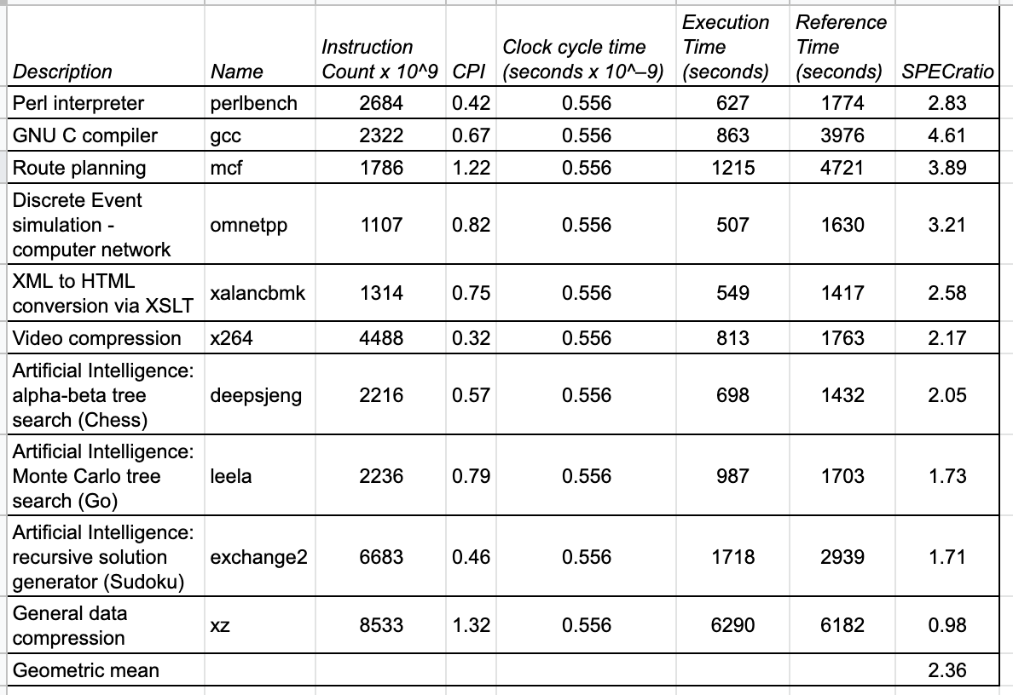
SPECspeed 2017 Integer benchmarks on a
1.8 GHz Intel Xeon E5-2650L
Chapter 1 — Computer Abstractions and Technology — <number>
Notes:
Morgan Kaufmann Publishers
Chapter 1 — Computer Abstractions and Technology

Slide 20

SPEC Power Benchmark
Power consumption of server at different workload levels
  Performance: ssj_ops/sec
  Power: Watts (Joules/sec)
Chapter 1 — Computer Abstractions and Technology — <number>
Notes:
Morgan Kaufmann Publishers
Chapter 1 — Computer Abstractions and Technology

Slide 21
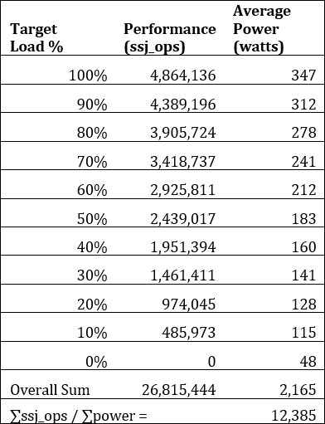
SPECpower_ssj2008 for Xeon E5-2650L
Chapter 1 — Computer Abstractions and Technology — <number>
Notes:
Morgan Kaufmann Publishers
Chapter 1 — Computer Abstractions and Technology

Slide 22


Pitfall: Amdahl’s Law
Improving an aspect of a computer and expecting a proportional improvement in overall performance
§1.11 Fallacies and Pitfalls
Example: multiply accounts for 80s/100s
  How much improvement in multiply performance to get 5× overall?
  Can’t be done!
Corollary: make the common case fast
Chapter 1 — Computer Abstractions and Technology — <number>
Notes:
Morgan Kaufmann Publishers
Chapter 1 — Computer Abstractions and Technology
corollary ผลที่ตามมา

Slide 23
Fallacy: Low Power at Idle
Look back at i7 power benchmark
  At 100% load: 258W
  At 50% load: 170W (66%)
  At 10% load: 121W (47%)
Google data center
  Mostly operates at 10% – 50% load
  At 100% load less than 1% of the time
Consider designing processors to make power proportional to load
Chapter 1 — Computer Abstractions and Technology — <number>
Notes:
Morgan Kaufmann Publishers
Chapter 1 — Computer Abstractions and Technology

Slide 24

Pitfall: MIPS as a Performance Metric
MIPS: Millions of Instructions Per Second
  Doesn’t account for
    Differences in ISAs between computers
    Differences in complexity between instructions
  CPI varies between programs on a given CPU
Chapter 1 — Computer Abstractions and Technology — <number>
Notes:
Morgan Kaufmann Publishers
Chapter 1 — Computer Abstractions and Technology

Slide 25
Concluding Remarks
Cost/performance is improving
  Due to underlying technology development
Hierarchical layers of abstraction
  In both hardware and software
Instruction set architecture
  The hardware/software interface
Execution time: the best performance measure
Power is a limiting factor
  Use parallelism to improve performance
§1.12 Concluding Remarks
Chapter 1 — Computer Abstractions and Technology — <number>
Notes:
Morgan Kaufmann Publishers
Chapter 1 — Computer Abstractions and Technology

Slide 26
Homework
1.14 Self-Study
Exercises
  1.7
  1.12
Chapter 1 — Computer Abstractions and Technology — <number>

